Slide 1
Data Warehouse Architecture for Healthcare

Slide 2
Objective
Develop a comprehensive data warehouse architecture that provides basic database analytics and reporting services, gathers data from multiple sources, and creates metrics to drive clinical and operational performance improvement. The primary focus will be on the 1115 Medicaid Waiver DPP, while also supporting additional departmental projects.

Slide 3
Architecture Components
a. Data Sources:
Electronic Health Records (EHR): Data from patient records including diagnosis, treatments, and outcomes.
Claims Data: Insurance claims information for billing and reimbursements.
Operational Databases: Data from hospital management systems, staff schedules, and inventory.
1115 Medicaid Waiver DPP Data: Specific data related to funding, program metrics, and compliance.
External Sources: Public health databases, medical research studies, and demographic information.
b. Data Integration (ETL Processes):
ETL Tool: SQL Server Integration Services (SSIS)
Processes:
Extraction: Extract data from various sources including EHR, claims data, operational databases, and 1115 Medicaid Waiver DPP data.
Transformation: Clean, transform, and standardize data, applying business rules and ensuring data quality.
Loading: Load transformed data into staging and then into the data warehouse.
c. Data Storage:
Staging: SQL Server Management Studio (SSMS) for temporary storage of data from the data sources received by the ETL process.
Data Warehouse: SQL Server Management Studio (SSMS) for structured storage of integrated healthcare data.
Data Marts: Create data marts for specific functional areas (e.g., clinical, operational, financial) using SQL Server Analysis Services (SSAS).
d. Data Modeling:
Dimensional Modeling: Implement star schema for fact and dimension tables. Examples include PatientDim, ProviderDim, TreatmentFact, ClaimsFact, and ProgramMetricsFact.
Slowly Changing Dimensions (SCD): Use SSIS data flow transformation for handling SCD, especially for program-specific data.
e. Data Access and Visualization:
Reporting Tools: Power BI, Tableau
Reports and Dashboards:
Interactive dashboards for clinical performance, operational efficiency, and compliance with the 1115 Medicaid Waiver DPP.
Drill-down reports for detailed analysis of patient outcomes, resource utilization, and program-specific metrics.
Geographical visualizations for disease spread and program impact areas.
f. Data Quality and Documentation:
Data Quality Checks: Implement validation processes to ensure data accuracy and consistency by implementing a control framework
Documentation: Maintain comprehensive documentation for source-to-target mappings, ETL processes, data models, and program-specific requirements.

Slide 4
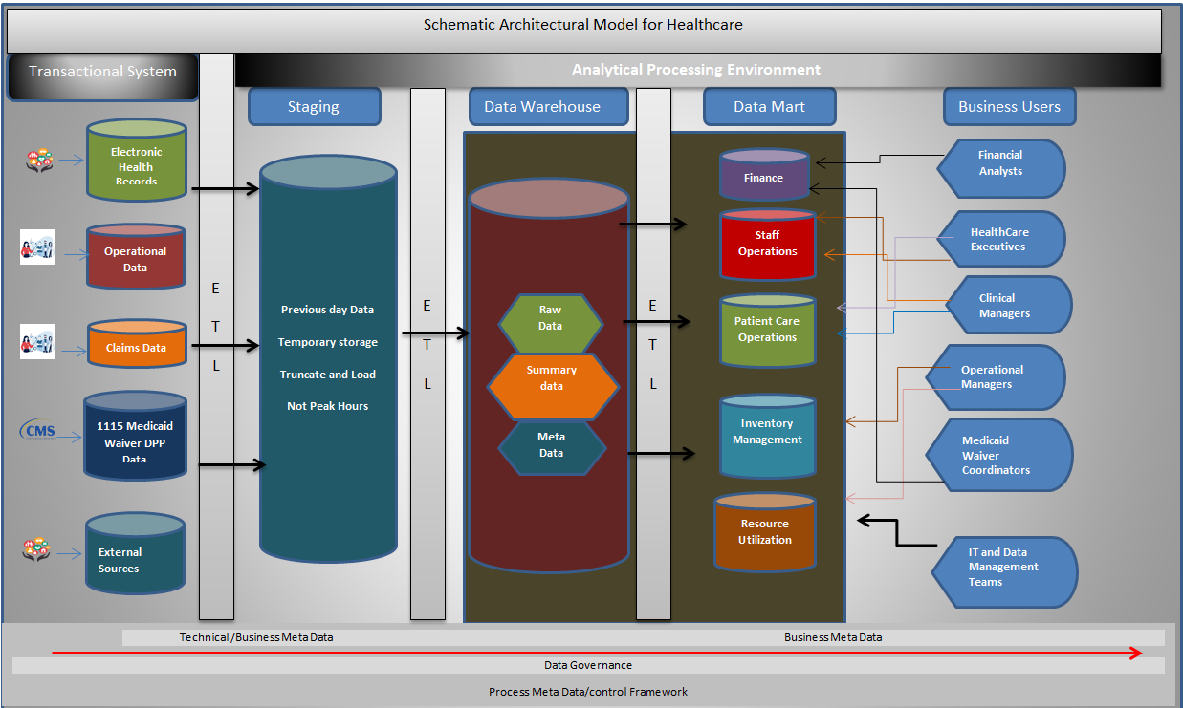
Proposed Data Warehouse Architecture

Slide 5
Project Plan
a. Requirements Gathering:
Gather and document data requirements from clinicians, executives, and other stakeholders to understand their analytical needs.
b. Design Phase:
Examine and translate requirements into technical specifications, process, and workflows.
Design the data warehouse architecture, data models, and ETL processes based on gathered requirements.
c. Development Phase:
Develop ETL processes, data models, and visualizations.
Produce relevant, standard, or custom information (reports, dashboards, charts, graphs, and tables) from various data sources.
Perform thorough testing to ensure data quality, reliability, and integrity.
d. Deployment Phase:
Deploy the data warehouse and data marts.
Distribute and disseminate reports to applicable agencies, researchers, management, and other customers.
Train users on accessing reports and dashboards.
e. Maintenance and Optimization:
Regularly monitor and optimize ETL processes, data models, and reports for performance and compliance.
Update and enhance reports and dashboards based on user feedback and program requirements.

Slide 6
Key Features
Scalable Architecture: Designed to handle growing data volumes and evolving healthcare needs.
User-Friendly Visualizations: Intuitive and interactive dashboards for clinical and administrative users.
High Data Quality: Rigorous data quality checks and validation processes.
Comprehensive Documentation: Detailed documentation for all aspects of the project, ensuring continuity of process.

Slide 7
Final Points
By implementing this architecture, the healthcare organization can effectively provide basic database analytics and reporting services, gather and analyze data from multiple sources, and create metrics to drive clinical and operational performance improvement while focusing on the 1115 Medicaid Waiver DPP.

Slide 8
THANK YOU
Benedicta Odhegba
onomeitimi@gmail.com

